Slide 1



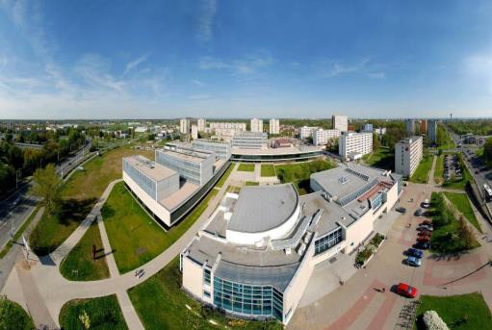

Education and Research at the University of Pardubice

Slide 2
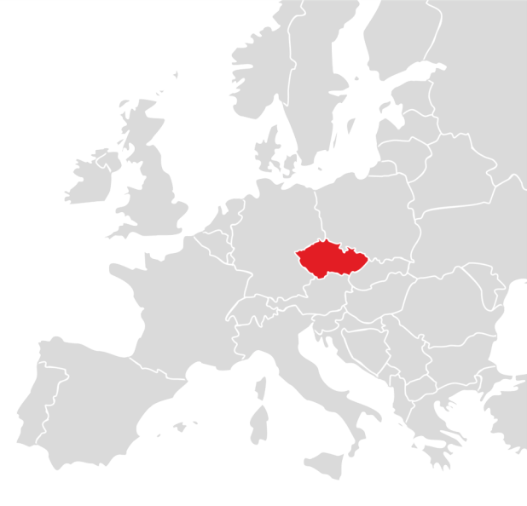

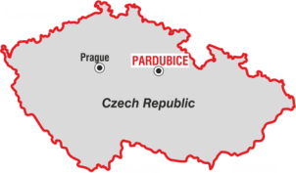
University of Pardubice
www.uni-pardubice.eu

Slide 3

Advancing Knowledge and Technologies to improve the quality of life
University of Pardubice
modern and dynamic public higher education institution in the heart of Europe
extends 65-year long tradition of higher education in the city of Pardubice
the only university in the Pardubice Region
one of the 26 public higher education institutions in the Czech Republic

Slide 4
5 Historical Milestones
University of Pardubice
1950 – 1989
1950 Institute of Chemistry in Pardubice
1953 Institute of Chemical Technology in Pardubice
an only chemistry related higher education institution – politically dependent on state
1990 – 2000
the Higher Education Act 1990 (HEA) – autonomy & academic freedom – new faculties/institutes
1994 University of Pardubice
2000 – 2009
the Higher Education Act 2001, Strategy of Tertiary Education Development
7 faculties 65 study programmes / 130 study specializations – 11 thousand students
2009 – 2014
State financial policy changes, EU Operational programmes
new infrastructure – modern university campus
2015 – 2020
Amendment to the Higher Education Act – new challenges – Horizon 2020

Slide 5
7 Faculties
University of Pardubice
Chemical Technology
Economics and Administration
Transport Engineering
Arts and Philosophy
Health Studies
Restoration
Faculty of Electrical Engineering and Informatics

Slide 6
University of Pardubice
8 000 Students at 7 Faculties

Slide 7
Students in 63 Study Programmes
University of Pardubice
16 Doctoral – PhD.
22 Master´s – Ing. Mgr., MgA.
25 Bachelor´s – Bc., BcA.
30 %
70 %
38 Postgraduate
25 Undergraduate

Slide 8
Students in the two Forms of Study
University of Pardubice
Part-time
Full-time

Slide 9
University of Pardubice
Study & Research & Technology Transfer
Natural and Technical Sciences
chemistry, chemical technology, biotechnology and biochemistry, informatics, electrical engineering, transport engineering, communication technologies,
materials science and nanotechnologies
Social Sciences
economics and administration, philology, history, philosophy, humanities, sociology
Health Sciences
nursing, midwifery, paramedic, health and social care
Fine Arts
historical preservation, art restoration, conservation techniques and technologies

Slide 10

Undergraduate and Postgraduate degree courses taught in English
Faculty of Transport Engineering
Transport Technology and Communications (Bc.)
Applied Informatics in Transport
Transport Engineering and Communications (Ing.)
Transport Means
Applied Informatics in Transport
Technique and Technology in Transport and Communications (Ph.D.)
Transport Means and Infrasturcture
Technology and Management in Transport and Telecommunications

Slide 11

Undergraduate and Postgraduate degree courses taught in English
Faculty of Economics and Administration
System Engineering and Informatics
Regional and Information Management (Bc. & Ing.)
Informatics in Public Administration (Ph.D.)
Economic Policy and Administration
Regional Development and Governance (Ing.)
Regional and Public Economics (Ph.D.)
Applied Informatics (Ph.D.)

Slide 12

Undergraduate and Postgraduate degree courses taught in English
Faculty of Arts and Philosophy
Specialisation in Educational Sciences (Bc.)
English for Education
Teacher Education for Lower Secondary Schools
English Language Teacher Education (Mgr.)
Historical Sciences (Ph.D.)
History
Philosophy (Ph.D.)
Philosophy
Studies of Religions

Slide 13
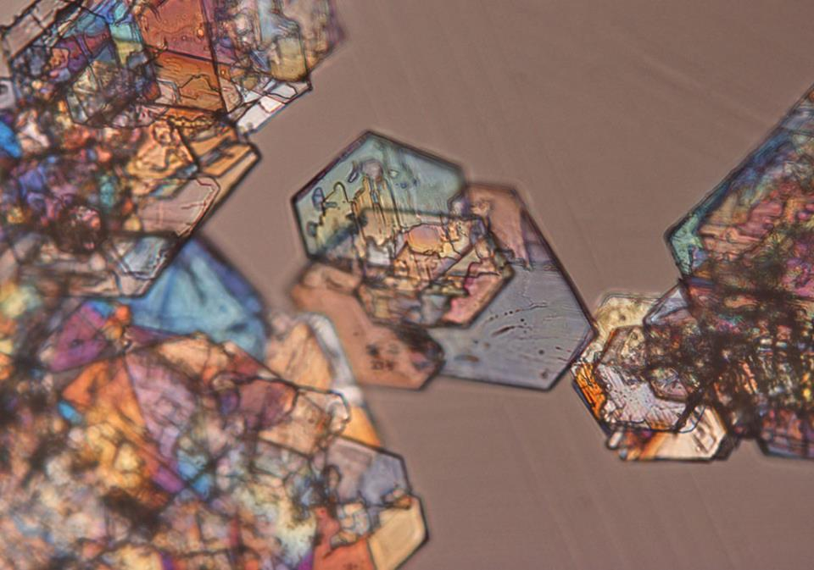
Doctoral degree courses taught in English
Faculty of Chemical Technology
Analytical Chemistry
Chemistry and Chemical Technology
Chemical and Process Engineering
Chemistry and Technology of Materials
Inorganic Chemistry
Organic Chemistry
Physical Chemistry

Slide 14

Doctoral degree courses taught in English
Faculty of Electrical Engineering and Informatics
Electrical engineering and informatics
Information, Communication and Control Technologies

Slide 15
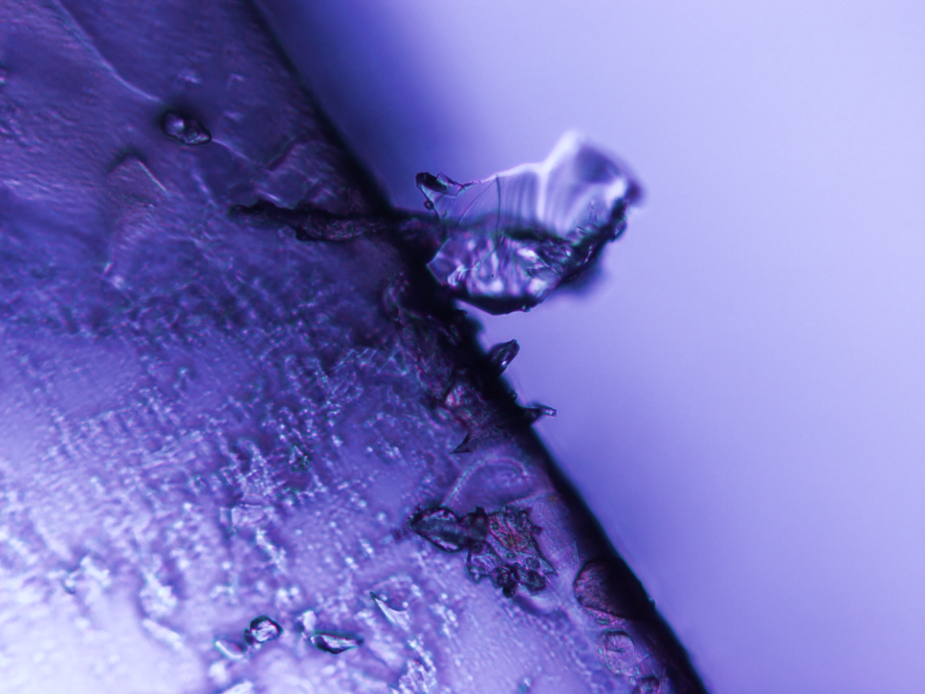
University of Pardubice
Fields of scientific interests and cooperation
Materials science and nanotechnologies in the field of chemistry
Transport engineering and infrastructure, logistics, communication technologies
Electrical engineering, signal and information processing
Regional development, information, security and risk management
Cultural, gender and modern history and interreligious dialogue
Art restoration and conservation technologies
Health management and health care

Slide 16

Research, Science & Technology Transfer
University of Pardubice
Ranks among the top 10 Czech universities
Universal scale of scientific disciplines
Fundamental and applied research
270 publications in impacted journals per year
International cooperation & projects
Tens of scientific conferences
360 applied service contracts
4 new patents & 5 applied samples
Centre for Technology & Knowledge Transfer

Slide 17
1,142 University Employees
University of Pardubice
608 Academic Staff
Professors
Lecturers
Senior Lecturers
534 Others

Slide 18
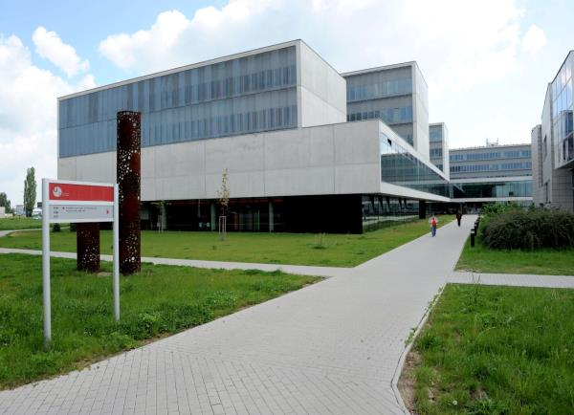
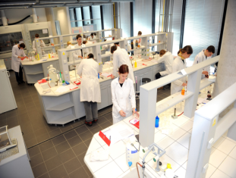
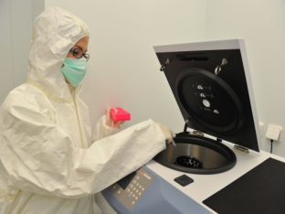
Recent Major Investments building modern infrastructure
University of Pardubice
Faculty of Chemical Technology
University campus & sports facilities

Slide 19
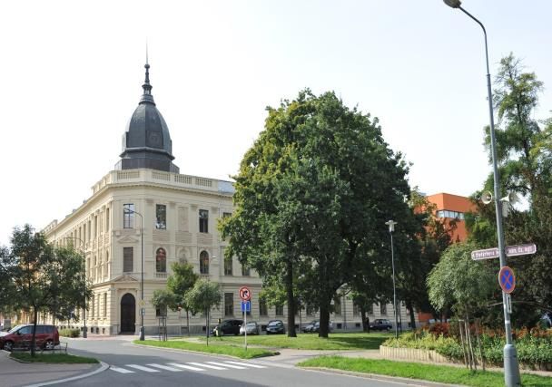
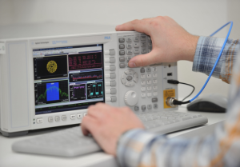
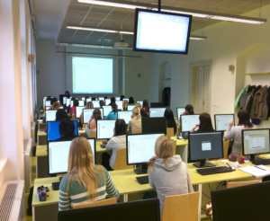
European Regional Development Fund
University of Pardubice
UNIT
Reconstruction of the historical building
University IT Centre in the city centre

Slide 20
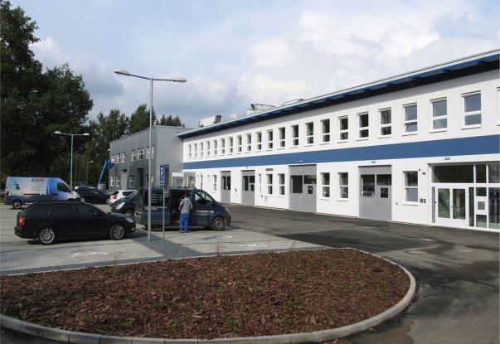
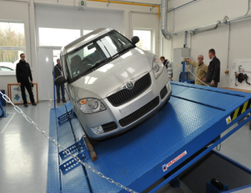
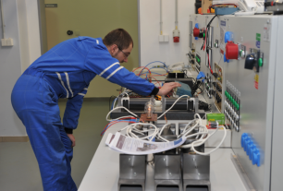
University of Pardubice
European Regional Development Fund
VVCD
New capacities for transport engineering disciplines
Educational and Reseach Centre in Transport

Slide 21
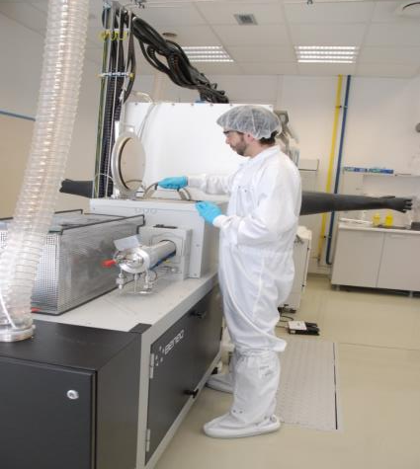
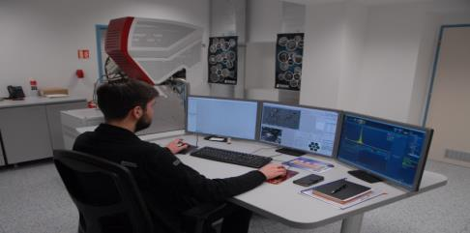
University of Pardubice
European Regional Development Fund
Reconstruction
Research capacities for Materials Science and Nanotechnologies in the city centre
CEMNAT

Slide 22
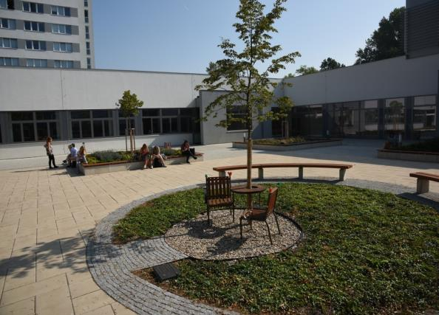
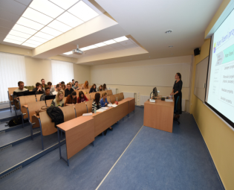
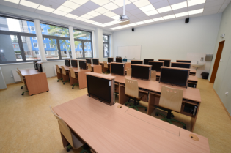
University of Pardubice
European Regional Development Fund
VAP
Reconstruction
Lecturing Halls and Soft Labs in the University Campus

Slide 23

International Cooperation in Education
University of Pardubice
ERASMUS+
ERASMUS MUNDUS
CEEPUS
International Cooperation in Research
Joint projects
PhD & Postdoc programmes
Technology & Knowledge Transfer
over 350 institutions
in 40 countries
Conferences & symposiums

Slide 24
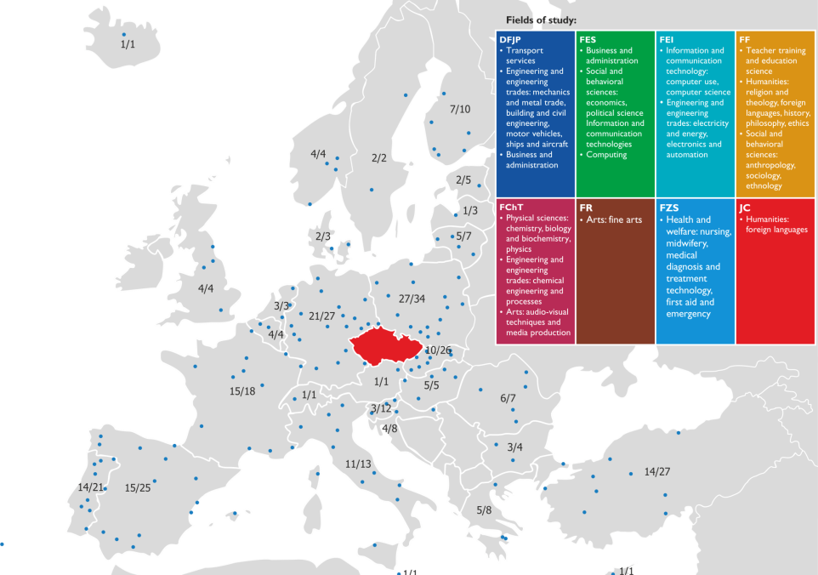
Erasmus+
University of Pardubice
214 Universities
324 Agreements

Slide 25
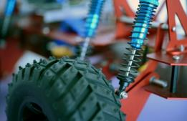
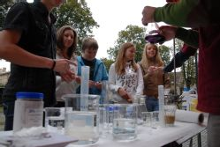
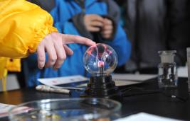
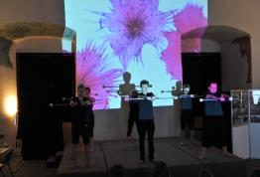
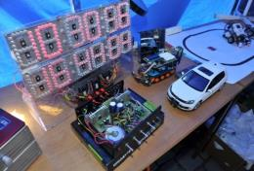
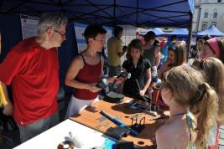
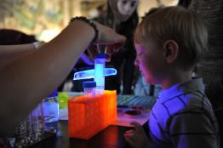
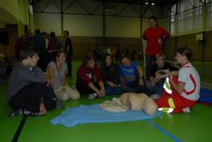

Open Door to Scientific Knowledge
University of Pardubice
Communicating Science & Technology plus R&D popularization

Slide 26

Infrastructure & Support Services
University of Pardubice
Modern campus and quality services
ICT support
University library and access to world information databases
Physical education and sport courses and clubs
Language centre and certified courses
Information and counseling centres
Academic consultancy for students with special needs
Assistance and support to disadvantaged students
International Mobility Centre
Career centre
Programmes and awards for talented students

Slide 27
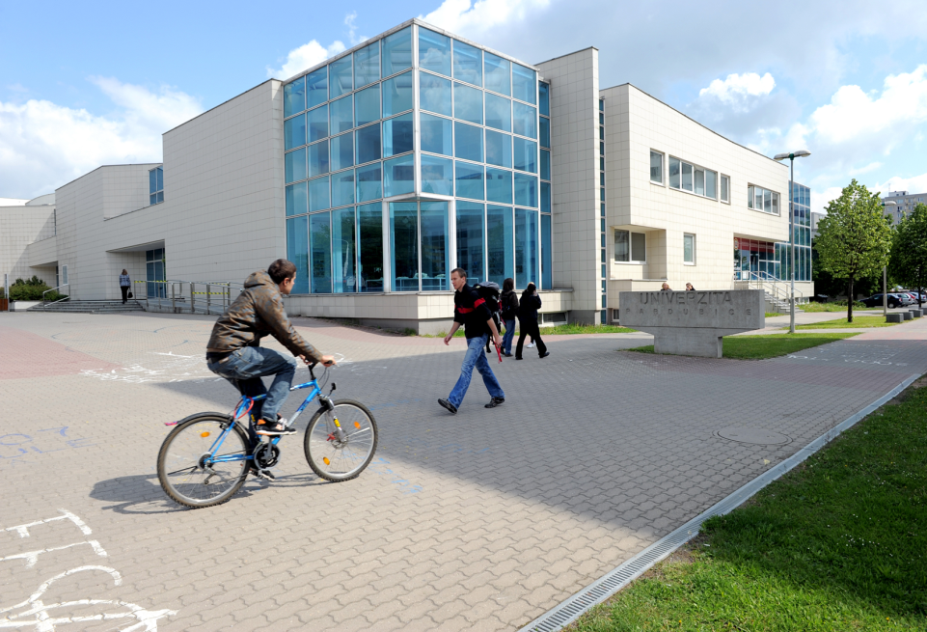
University Campus – Library – ICT
University of Pardubice
University Library
Information and Communication Technologies
8,000 readers
204,729 volumes
686 periodicals
26 databases
280 study rooms (seating capacity) 30 PC work stations
Self-service copying
University Art Gallery
Free WiFi Access
CESNET 2 Internet network & speed 10 Gb/s
3,500 PC working stations
90 PC labs with 1,120 computers
280 zero clients & 650 virtual desktop systems
13,000 PC accounts
Printers and scanners

Slide 28

Physical Education & Sports
University of Pardubice
Department of Physical Education and Sports since 1953
University sports club since 1959
Compulsory and optional physical education
Sports courses and events – interfaculty competitions
Team and individual sports – Rector‘s Award
Participation in academic games and other sports events
New sporting facilities – indoor & outdoor

Slide 29
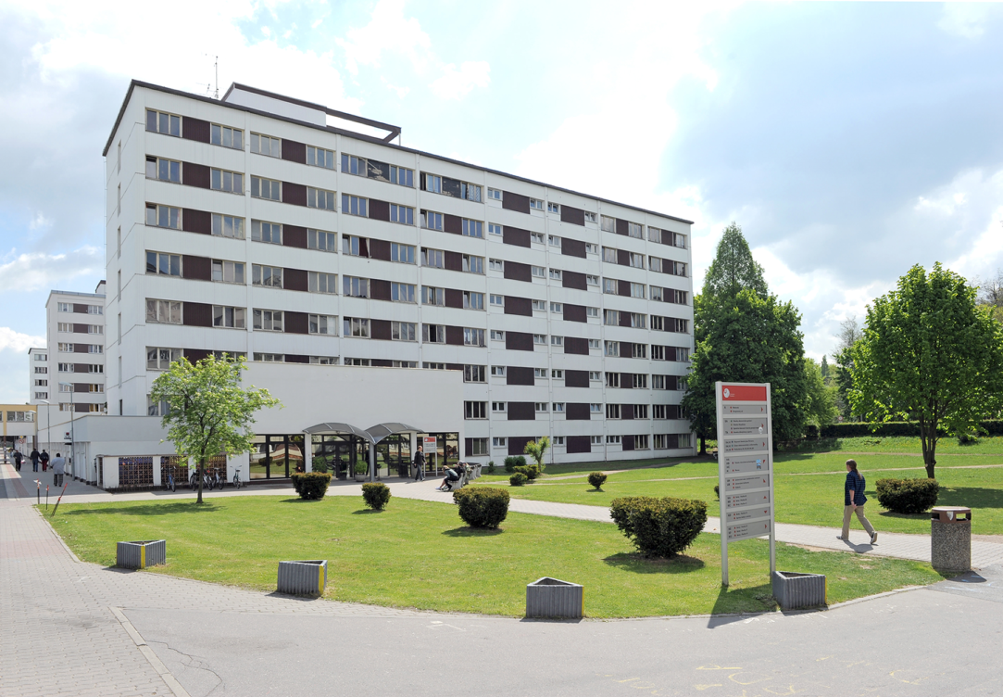
Accommodation & Dinning
University of Pardubice
Halls of Residence
Mensa – Dinning Hall
1,650 beds
2,400 – 4,000 CZK (120 – 200 USD) / month
Internet access in all rooms
Student clubs
4 dinning halls
400 seating capacity
320,000 meals per year
Cashless payment with student/employee cards

Slide 30

Students coming from 55 countries appreciate:
University of Pardubice
Quality study programmes
International and lively student community
Modern university campus
Excellent study conditions and facilities
Good transport accessibility
Reasonable living costs in the city with 100,000 inhabitants
Pleasant environment of the East Bohemia region
Extensive sports and cultural opportunities

Slide 31
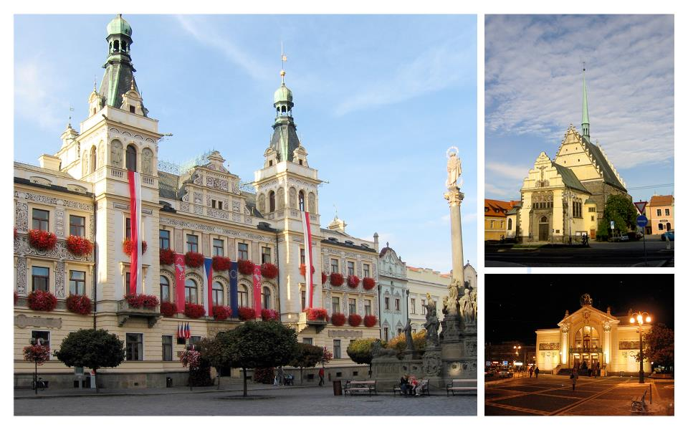
Pardubice

Slide 32
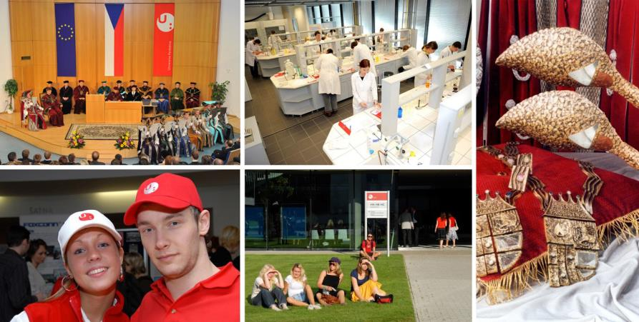
University of Pardubice
The modern facilities of the University campus near the city centre create ideal conditions for the all-around development of young people.
Pleasant surroundings and many sports and cultural life opportunities in combination with quality and demanding study programmes are recognized among other European universities.

Slide 33

Quality & Tradition
University of Pardubice University for the Future
prepares specialists for successful careers in a wide variety of professions
contributes to the development of a knowledge-based society
active part of the European and world higher education and research area

